Slide 1

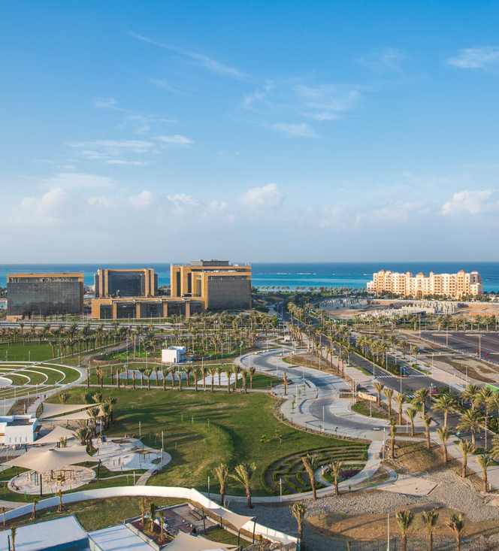
The Tourist Side Of KAEC

Slide 2
Results

Slide 3
First Scene

Slide 4
Juman Park

Slide 5
Beach Cinema

Slide 6
Golf Park

Slide 7
Yam Beach

Slide 8
Beach walk

Slide 9
Name | ID | Section
Raneem Algrni | 1705312 | DAR ZZ
Asmaa Hakami | 1775369
Esraa Maghrabi | 1708297
Rahaf Alrowithi | 1705179
Sara Alhadrami | 1707422
Mahila Almutairi | 1706603

Slide 10


